Slide 1
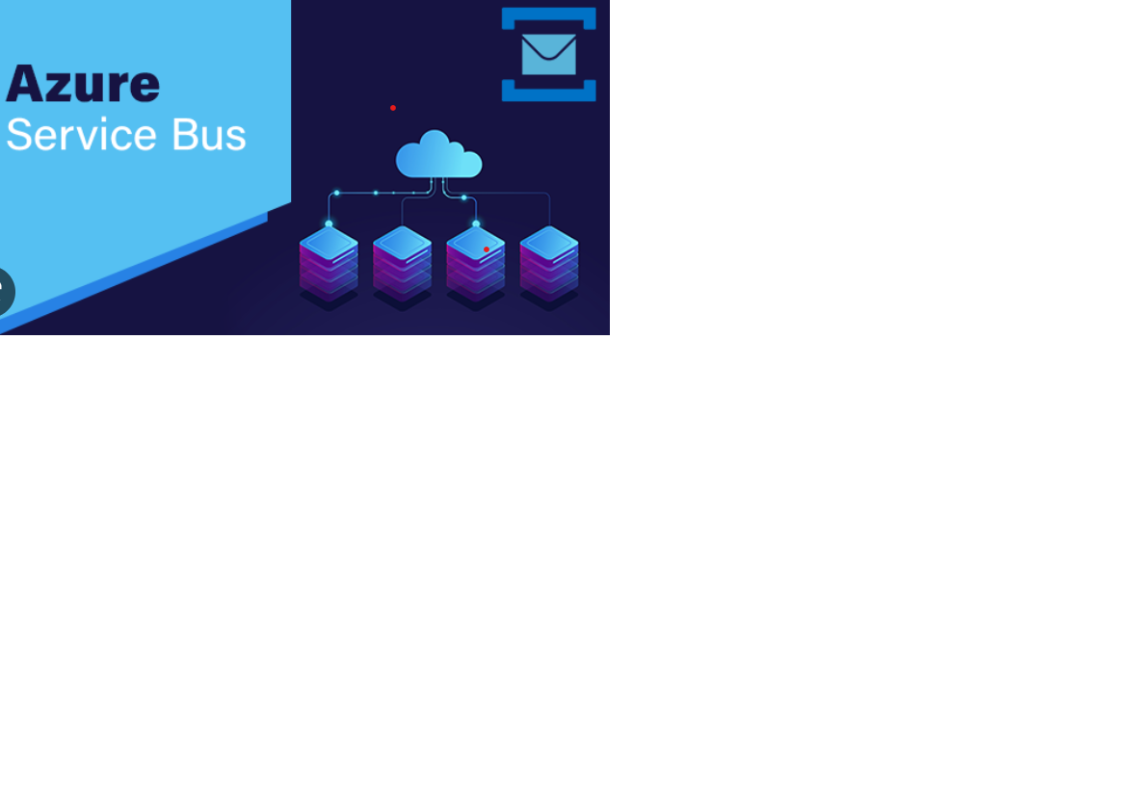
AZURE SERVICE BUS

Slide 2
Agenda
What is Service Bus
Architecture
Why Service Bus
Features
Bus Serices

Slide 3
INTRODUCTION
Azure Service Bus is the technology used to implement messaging and eventing in cloud-based applications
Azure Service Bus is a cloud-based messaging platform.
It's one of the services in the Azure cloud platform, and it allows you to build highly scalable distributed systems that can send messages between applications or devices.

Slide 4
ARCHITECTURE
Azure Service Bus offers three types of communication mechanisms; queues, topics and, relays.
Queues and Topics, facilitate one-directional communication. Messages will be stored until they are consumed. Each message in Queue is received by a single recipient.
Topic can have multiple subscriptions for multiple receivers. Subscriptions can choose to receive messages based on parameters. Messages from Queues and Topics can be accessed using Service bus-defined messaging APIs or REST APIs.
SDKs are also available for other languages. Unlike Queues and Topics; Relays provide bi-directional communication and does not store messages.
To use these messaging services, user must create namespace under Azure subscription. A namespace can be visualized as a logical container for messaging components. Multiple Service Bus components (queues, topics and relays) can reside within a single namespace.

Slide 5
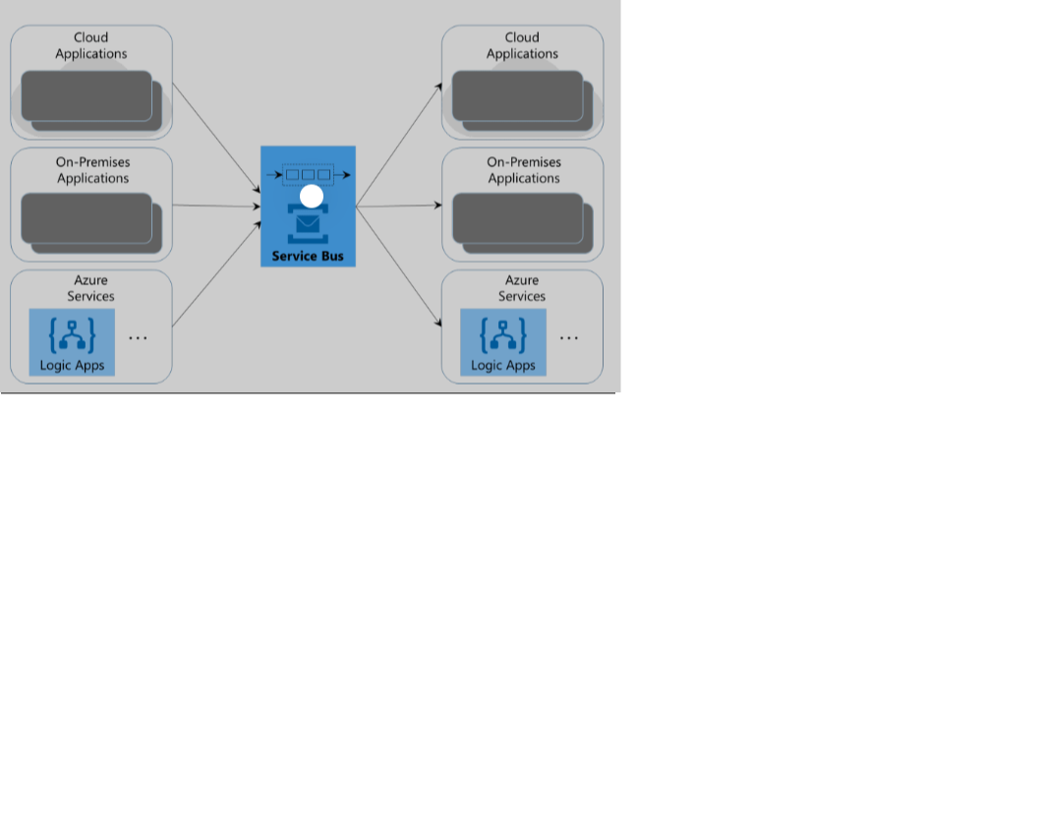
WHY SERVICE BUS
As Azure Service Bus is fully managed service, scaling and availability will be taken care by Azure team.
It is integrated with other Azure Services like, Event Grid, Logic apps, Stream Analytics etc.
Azure Service Bus provides reliable and secure asynchronous message communication platform along with facility of delayed processing of events or data .

Slide 6
BUS TIER WITH FEATURES
STANDARD TIER:
PREMIUM:
It can be used for initial development and QA environment deployments.
Latency and throughput in Standard tier are variable, hence performance is not predictable.
In built scaling is also not available and maximum message size is up to 256 kb.
It can be used for Production deployments. It provides high throughput and auto scaling for variable workloads.
Maximum message size can be up to 1mb. Premium name spaces provides CPU and memory level isolation for resources.
Notes:
(These don’t have designer IDs since they were based off the default master slides already in the deck.

Slide 7
SERVICES
QUEUES
TOPICS
RELAYS
Queues messaging service offers First In First Out data delivery.
It enables ordered handling of unbounded sequences of related messages.
Message sessions is used to ensure a first-in, first-out (FIFO).
Topics is nothing but single input queue but multiple output queues.
Output queues are nothing but Subscriptions.
Receiving apps needs to create subscriptions to receive messages from Topic.
Queues and Topics provides unidirectional messaging.
To facilitate bi-directional communication, Azure provides Relay messaging service.
In Queues or Topics there is no explicit connection between sender and receiver.

Slide 8
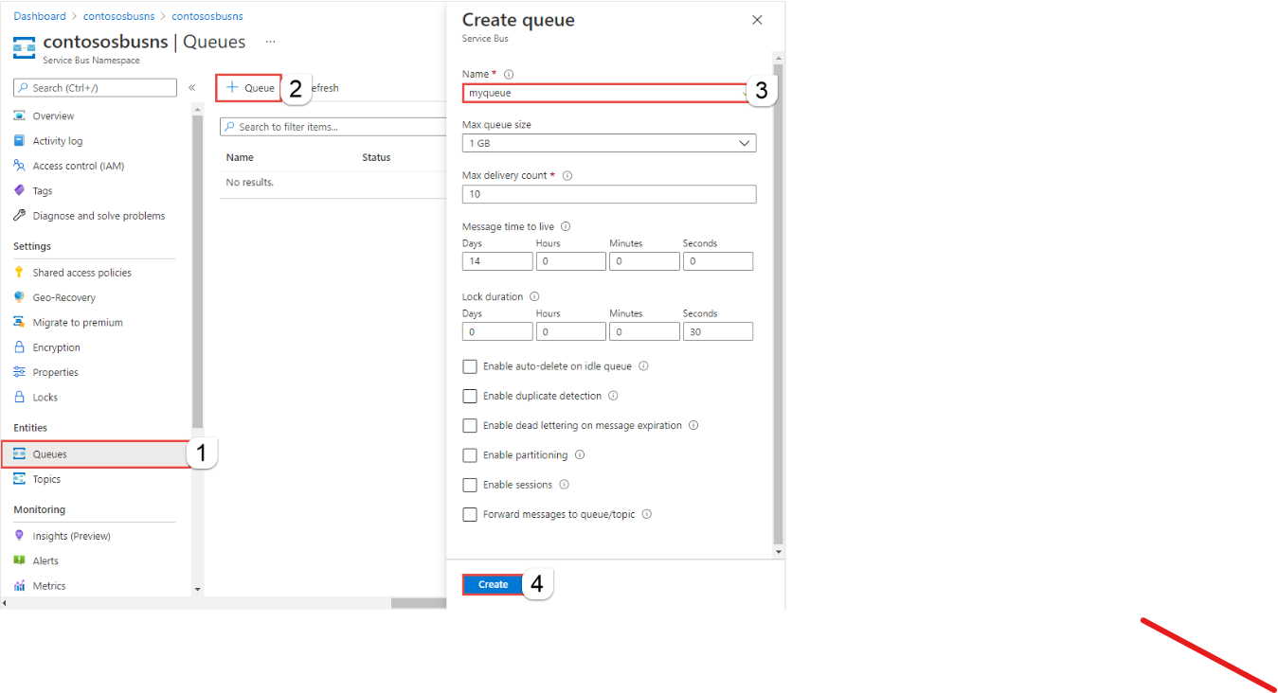
Creating A Queue

Slide 9

Presented by
Sonia Netinti

